Slide 1
Paycheck Protection Program
Revisions to Loan Amount Calculation and Eligibility
First and Second Draw PPP Loans

Slide 2
Paycheck Protection Program (PPP)
Before We Get Started…
Recording: The webinar is not being recorded
Questions: Submit your questions in the Q&A panel – we will not answer today but will use your questions to inform future FAQs
Closed Captions: Turn on captions/subtitles in the video controls from the menu at the bottom of your screen
Sound: Sound issues are generally user broadband issues – If you lose sound or experience echoing:
Exit the event and re-enter
Hit F5 to refresh screen/click your mouse key anywhere
Use Microsoft Edge or Google Chrome
Help: Microsoft website with Microsoft Live audience help tips:
Help on attending a live event in Teams - Office Support (microsoft.com); or
Do an internet search for “Attend a Live event in teams”; Choose the link that begins with https://www.support.microsoft.com

Slide 3
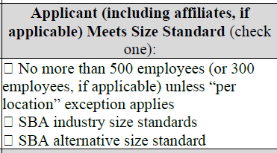
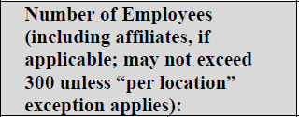
Paycheck Protection Program (PPP)
Reporting Number of Employees
Each of the new Borrower Applications provide instructions on counting number of employees:
  Average employment over the time period used to calculate aggregate payroll costs
  Average number of employees per pay period in the 12 completed calendar months prior to the date of loan application
  “Per location” added to the applications for clarification on NAICS 72 and news organizations
First Draw Application
Second Draw Application
Notes:
Restaurants: The platform has been updated to resolve the NAICS 72 issue on number of employees. Lenders can submit loans for hotels/restaurants and news organizations without issues.

Slide 4
Paycheck Protection Program (PPP)
Exclusivity Period for Applications
Wed., Feb. 24th 9:00 am through Tues., March 9th
  SBA is only accepting applications from borrowers with fewer than 20 employees
  All applications already submitted by lenders to SBA before the start of the exclusivity period will still be processed
  During the exclusivity period, SBA is rejecting any new applications for employers that have 20 or more employees
  Counting employees: Each employee counts as one, regardless if full-time, part-time, or seasonal

Slide 5
Schedule C Filers
Revisions to Loan Amount Calculation
First and Second Draw PPP Loans
These revisions are not retroactive
IFR and new application forms posted on Treasury and SBA’s website (links on slide 19)
SBA will begin accepting new applications for Schedule C filers on Friday, March 5, 2021
5

Slide 6
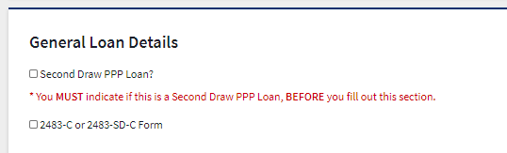
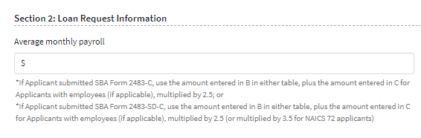
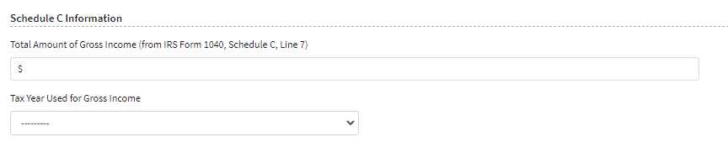
Screen shots from the Platform
Notes:
These are screen shots from the Platform that highlight the new elements that the Platform collects.
This is an early view but should be close to what will be in the Platform tomorrow.
Lenders will only see these options if the Lender indicates the applicant is using the Schedule C form.

Slide 7
Paycheck Protection Program (PPP)
Schedule C Filers – Next Steps for Lenders and Borrowers
  Lenders:
    If you submitted an application to the platform and it has not yet been approved, you may withdraw the application from the Paycheck Protection Platform
    If the application has been approved but the loan has not yet been disbursed, you may cancel the loan in E-Tran Servicing and the applicant may apply for a new loan using the new application form
    If you have disbursed the loan but you have not yet filed the related Form 1502, you may cancel the loan in E-Tran Servicing and the applicant may repay and apply for a new loan using the new application form
    If you have disbursed the loan and filed the related Form 1502, the loan cannot be canceled
    Revisions to loan amounts must be made by using the new loan application forms (no loan increases)
    Note: The cancellation process does not occur on the Platform – loans must be canceled in E-Tran Servicing; Data in Platform may take up to 2 days to update actions in E-Tran Servicing (can’t enter new loan application until the Platform recognizes the prior loan’s cancellation)
7

Slide 8
Paycheck Protection Program (PPP)
Schedule C Filers – Partnerships & LLCs
Question: Are partnerships and LLCs included in the revisions for Schedule C filers?
Answer:
Partners and partnerships are not included in the revisions
Single-member LLCs that file Schedule C are included*
Qualified joint ventures as defined by IRS are included*:
  The only members are a married couple who file a joint return
  Both spouses materially participate in the business
  Both spouses elect not to be treated as a partnership
  Other limitations apply – see IRS definition for full details
*Forms 2483-C and 2483-SD-C provide instructions for #employees & income
Notes:
IRS definition of qualified joint venture: Election for Married Couples Unincorporated Businesses | Internal Revenue Service (irs.gov) A qualified joint venture is a joint venture that conducts a trade or business where (1) the only members of the joint venture are a married couple who file a joint return, (2) both spouses materially participate in the trade or business, and (3) both spouses elect not to be treated as a partnership. A qualified joint venture, for purposes of this provision, includes only businesses that are owned and operated by spouses as co-owners, and not in the name of a state law entity (including a limited partnership or limited liability company). Note also that mere joint ownership of property that is not a trade or business does not qualify for the election. The spouses must share the items of income, gain, loss, deduction, and credit in accordance with each spouse's interest in the business. The meaning of “material participation” is the same as under the passive activity loss rules in section 469(h) and the corresponding regulations (see Publication 925, Passive Activity and At-Risk Rules)…. ….

Slide 9
Paycheck Protection Program (PPP)
More flexibility for Schedule C Filers
For borrowers that file IRS Form 1040 Schedule C:
  “Income” now encompasses borrower’s net income and gross income to account for fixed and other business expenses
  The revised definition of income allows revisions to the loan amount calculation
Application Forms:
  SBA Form 2483-C or 2483-SD-C: Only for Schedule C filers using gross income
  SBA Form 2483 or 2483-SD: If using net income to calculate loan amount or if using Schedule F (either gross or net)
Notes:
Previously, PPP rules defined payroll costs for individuals who file an IRS Form 1040, Schedule C as payroll costs (if employees exist) plus net profits, which is net earnings from self-employment. SBA is aware of concerns with this definition, because it does not take into account fixed and other business expenses that a small business must cover to stay in operation and therefore keep the owner employed. Thus, the support for employment for sole proprietors includes covering business expenses as well as net profits. This change would affect sole proprietors who have been effectively excluded from the PPP, especially those with very little or negative net profit.

Slide 10
Paycheck Protection Program (PPP)
Owner Compensation
Why is “Owner Compensation” important? The new definition of owner compensation allows applicants to use either net profit or gross income in its calculation of total payroll costs.
Schedule C filer - no employees: Owner compensation is either gross income (line 7) or net profit (line 31)
Schedule C filer – with employees:
Owner compensation:
    Net profit (line 31); or
    Gross income (line 7) minus:
      Line 14 (Employee benefit programs)
      Line 19 (Pension and profit-sharing); and
      Line 26 (Wages less employment credits)
Owner compensation does not include employee payroll costs (this is why lines 14, 19, & 26 are subtracted from gross income to determine owner calculation)
Owner compensation + employee payroll costs (from Form 941) = total payroll costs

Slide 11
Paycheck Protection Program (PPP)
Revised Formula – Schedule C Filer No Employees
First Draw PPP Loan - For Schedule C filer with no employees:
Step 1: From 2019 or 2020 IRS Form 1040, Schedule C, line 31 net profit or line 7 gross income
    If this amount is over $100,000, reduce it to $100,000.
    If both your net profit and gross income are zero or less, you are not eligible for a PPP loan
Step 2: Calculate the average monthly net profit or gross income amount
(divide the amount from Step 1 by 12)
Step 3: Multiply the average monthly net profit or gross income amount from Step 2 by 2.5
This amount cannot exceed $20,833
Step 4: Add the outstanding amount of any Economic Injury Disaster Loan (EIDL) made between January 31, 2020 and April 3, 2020

Slide 12
Paycheck Protection Program (PPP)
Revised Formula - Schedule C Filer with Employees
First Draw PPP Loan - For Schedule C filer with employees:
Step 1: 2019 or 2020 Schedule C;
1. Calculate owner compensation share of payroll costs - Use either:
  Net profit (line 31); or
  Gross income (line 7) minus employee payroll costs (lines 14, 19, & 26)
2. If #1 is more than $100,000, reduce to $100,000; If less than zero, set to zero
3. Add eligible employee payroll costs (cash and non-cash (e.g. employer contributions to employee group health insurance, retirement contributions, etc.))
Step 2: Calculate the average monthly amount (divide the sum from Step 1 by 12)
Step 3: Multiply the average monthly amount from Step 2 by 2.5
Step 4: Add the outstanding amount of any EIDL made between Jan. 31, 2020 and April 3, 2020

Slide 13
Paycheck Protection Program (PPP)
Second Draw PPP Loans
Same rules for loan amount calculation as First Draw PPP loan calculation except:
  Loan amount may not exceed $2 million
  Borrower with NAICS code beginning with 72:
    Multiply average monthly payroll by 3.5
    For a Schedule C filer without employees - this amount cannot exceed $29,167
Note: Second Draw PPP Loan eligibility requirements continue to apply to Schedule C filers (e.g. 25% reduction in gross receipts, which includes affiliates)

Slide 14
Paycheck Protection Program (PPP)
SBA Review of Good Faith Loan Necessity Certification
First Draw PPP Loans:
  If using gross income and the borrower reported more than $150,000 in gross income on the Schedule C used to calculate loan amount:
    SBA may review Borrower’s certification concerning the necessity of the loan and whether the borrower complied with PPP eligibility criteria
    If a loan is picked for review, the review will follow the same processes that apply to all other PPP loan reviews
  Safe harbor applies if using:
    Gross income and the Borrower reported $150,000 or less in gross income on the Schedule C used to calculate loan amount; or
    Net income
Second Draw PPP Loans: Safe harbor applies because Applicants are required to certify that they had a reduction of gross receipts by at least 25%
14

Slide 15
Eligibility Revisions
15

Slide 16
Paycheck Protection Program (PPP)
Elimination of Restrictions – Non-Financial Fraud Felonies
Eliminated: Restrictions on businesses with owners who have prior non-financial fraud felony convictions
The elimination of the restriction is not retroactive
Remaining in place: Restrictions on businesses with 20% or more owner who:
  Has an arrest or conviction for a felony fraud related to financial assistance fraud within the past 5 years
  Is currently incarcerated for a felony at the time of application
Note: Lenders must continue following the process for resolving hold codes and compliance check error message previously announced (SBA Procedural Notice 5000-20092)
Notes:
The elimination of the restriction on non-financial fraud felonies is not retroactive. This means that if a borrower falsified their certification on their First Draw PPP Loan application by certifying that they did not have a non-financial fraud felony when they actually did, and if SBA found the felony as part of its compliance checks, the borrower will be found ineligible for their First Draw PPP Loan. And, because they were ineligible for their First Draw PPP Loan, they remain ineligible for a Second Draw PPP Loan even though now the restriction against non-financial fraud felonies is no longer in place.

Slide 17
Paycheck Protection Program (PPP)
Elimination of Restrictions – Student Loan Debt Delinquency & Defaults
Eliminated: Restriction on businesses owned or controlled by owners who have Federal student loan debt that is currently delinquent or has defaulted and caused a loss to the Federal government
Retroactive: This change applies to new PPP applicants as well as those who have already received a PPP loan (This is the only retroactive change implemented in the IFR)
SBA is automatically removing hold codes and compliance check error messages on loans related to Do Not Pay Education
Notes:
“Federal student loans” mean programs under Parts B, D and E of the Higher Education Act of 1965, as amended, as well as other programs now administered by the Department. These include loans under the under the William D. Ford Federal Direct Loan program, the Federal Family Education Loan (FFEL) program, the Federal Perkins Loan program, the Health Education Assistance Loan (HEAL) program, and the Teacher Education Assistance for College and Higher Education (TEACH) Grant program if those awards have converted into loans. These delinquencies include loans owed directly to the Department of Education as well as Federal student loans held by institutions of higher education or those guaranteed or insured by the Department of Education and which are held by private lenders or guaranty agencies.

Slide 18
Paycheck Protection Program (PPP)
Elimination of Restrictions – Non-Citizen Owners
Not in the IFR
All lawful US residents have access to PPP
E-Tran and the PPP platform permit the use of ITINs as the identifier for a business owned by a sole proprietor and for a principal
ITIN: Individual Taxpayer Identification Number
  Issued by IRS
  Nine-digit number with format: 9XX-XX-XXXX
  Always begins with “9”

Slide 19
Paycheck Protection Program (PPP)
Stay up to date…
FAQs
SBA's PPP Lenders page
SBA’s PPP First Draw page
SBA’s PPP Second Draw page
IFR – Revisions to Loan Amount Calculation and Eligibility
SBA Form 2483 – Borrower Application Form (First Draw)
SBA Form 2483-SD – Borrower Application Form – Second Draw
SBA Form 2483-C – Borrower Application Form – Schedule C Filer (using gross income) (First Draw)
SBA Form 2483-SD-C – Borrower Application Form – Second Draw – Schedule C Filer (using gross income)
SBA Form 2484 – Lender Application Form
SBA Form 2484-SD – Lender Application Form – Second Draw

Slide 20
Paycheck Protection Program (PPP)
Stay up to date…
Follow SBA on Twitter
Subscribe to SBA’s e-newsletter
Visit www.SBA.gov
White House Fact Sheet available at: https://whitehouse.gov
  From the menu in upper right corner
  Select “Briefing Room”
Best source of accurate information for:
  All COVID-19 economic aid programs administered by the SBA www.SBA.gov/coronavirusrelief
  For the PPP www.SBA.gov/ppp

