Slide 1
U.S. Small Business Administration Office of Capital Access
7(a) Connect Quarterly Update
April 22, 2025

Slide 2
Small Business Administration
Kelly Loeffler
Administrator
2

Slide 3
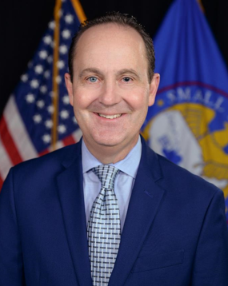
Office of Capital Access
Thomas Kimsey
Associate Administrator
3

Slide 4
Office of Capital Access
Dianna Seaborn
Deputy Associate Administrator
4

Slide 5
SBA Loan Guaranty Processing Center
Joe McClure
Acting Center Director
5

Slide 6
Our primary responsibilities include:
Origination - Processing Non-Delegated Guaranty Requests
Loan Modifications -Processing Pre-full disbursement
7aloanmod@sba.gov
Lender Support – Providing answers to lenders questions & validation error codes 7aQuestions@sba.gov
AND
Providing support to help clear compliance codes 7aComplianceCheck@sba.gov
7(a) LOAN GUARANTY
PROCESSING CENTER (LGPC)
Joe McClure, Center Director (Acting)
Office of Financial Programs and Operations (OFPO)
U.S. Small Business Administration

Slide 7
7(a) LGPC - Metrics
 | 12 Month Volume | Volume/Day | Response Time (last 30 days)*
Small Loans | 2,465 | 10 | 5
Regular (non-small) Loans | 1,891 | 8 | 16
Loan Mods | 7,980 | 33 | 1.5
E-Tran Compliance Checks | 16,255 | 68 | 1.5
7aQuestions | 22,893 | 95 | 5+
*Business Days to Screen-out or Approval

Slide 8
7(a) LGPC - Hot Topics
Owner’s Date of Birth (DOB) - SBA Procedural Notice # 5000-866498
SBA Lenders must enter the DOB for all owners and guarantors of an applicant business. (This is now a validation error)
The loan will NOT fund if this is not completed.
Environmental Policies and Procedures Notice # 5000-866054
SBA Lenders must certify that they will comply with SBA’s Environmental Policies
If the loan is being processed under non-delegated authority, Lender certifies that if the project includes real Property, and the Property is Contaminated, Lender will not disburse the loan unless the Environmental Investigation and the Environmental Investigation Report(s) have been approved by SBA.
The loan will NOT fund if this box is not checked.
Citizenship SBA Policy Notice # 5000-865754
SBA Lenders must certify in E-Tran that no Direct or Indirect Owner is an ineligible person.
The loan will NOT fund if this is box is not checked.
The loan will NOT fund if this box is not checked.

Slide 9
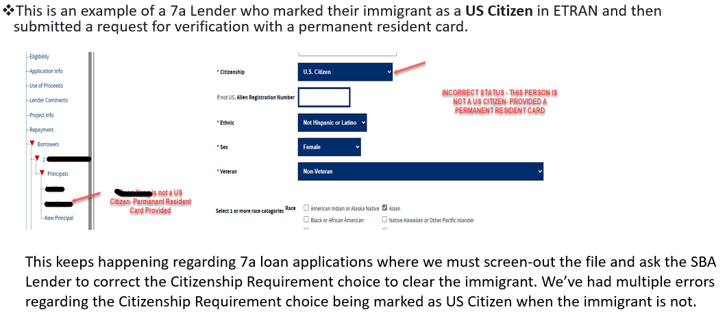
7(a) LGPC - Hot Topics
Citizenship SBA Policy Notice # 5000-865754 (clearing the immigrant)

Slide 10
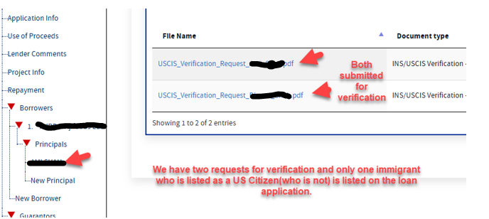
7(a) LGPC - Hot Topics
4. Citizenship SBA Policy Notice # 5000-865754 (clearing the immigrant)
This is an example of a 7a Lender who failed to enter the individual in ETRAN and then submitted a request for verification with a permanent resident card.
If the immigrant is not a borrower or principal on the loan but appears to have an interest in the potential business, then the lender needs to add them as a non-owner borrower/ principal on the loan application so that SLPC can clear the immigrant.

Slide 11
tOP SCREEN-OUT categories

Slide 12
NumBer One…
Financial Statements/Projections
1
2
3
4
5
6
7
8
Personal Financial Statement Incomplete
Projected Income Statements needed
Seller Financials Incomplete
Historical Financials Missing
Pro-forma Balance Sheet Missing
Affiliate financials Missing
Month-to-Month Projections Needed
Seller Financials Needed
Make sure that current YTD Business Financials are no older than 120 days from submission to SBA Make sure the Personal Financial Statement is no older than 120 days from submission to SBA

Slide 13
2nd on the list…
Credit Memo Incomplete
1
2
3
4
5
6
7
Collateral Shortfall - Real Estate Available
Unclear Use of Proceeds
Working Capital Request –Justification Needed
Justification For Projections
Possible Affiliates - Clarification Required
Schedule of Collateral Incomplete
Make sure that current YTD Business Financials are no older than 120 days from submission to SBA
Make sure the Personal Financial Statement is no older than 120 days from submission to SBA

Slide 14
3rd on the list…
Other (two major items)
Change of Ownership
Purchase Agreement For Business Needed
Lender’s Internal Business Valuation Missing
Independent Business Valuation Missing
Stock Purchase Agreement Needed
Debt Refinance
10% Improvement to Cash Flow Not Met
The debt to be refinanced must be, and must have been, current for at least 12 months or for the life of the loan, whichever is less. “Current means a required payment has not remained unpaid for more than 29 day.

Slide 15
Questions?

Slide 16
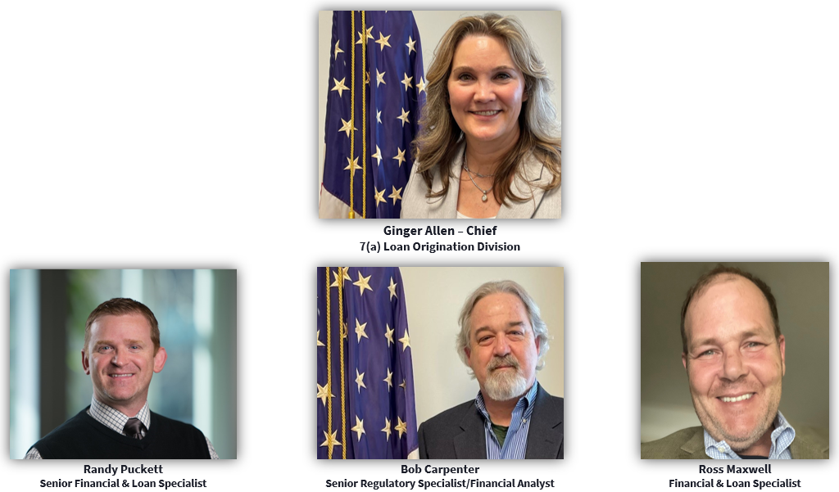
7(a) Loan Origination Division

Slide 17
Recent Notices
SBA Notices published recently:
Policy Notice 5000-865754, published 3/7/2025, Policy updates regarding citizenship requirements
Procedural Notice 5000-865355, published 3/14/2025, Rescission of SBA Procedural Notices Previously Published (CA SBLCs)
SBA Form 1919, updated 3/19/2025, to change “gender” to “sex” – Another update is coming!
Information Notice 5000-865585, published 3/19/2025, SBA Form 1919 Updated for EO 14168
Procedural Notice 5000-866054, published 3/20/2025, Update to Environmental Policies and Procedures (Training is now available on the SBA Training on Demand page)
Information Notice 5000-865775, published 3/24/2025, Revising 7(a) Fees for FY 2025
Procedural Notice 5000-866498, published 3/26/2025, Requirement to provide owner date of birth
Procedural Notice 5000-866946, published 4/15/2025, Revisions to SOP 50 57 3.1 for SBA’s Processing of Lender Guaranty Purchase Requests and Certain Servicing Actions

Slide 18
Procedural Notice 5000-866946 Update to SOP 50 57 3
Procedural Notice 5000-866946, published April 15, revised 7(a) Loan Servicing and Liquidation SOP standards that SBA applies when examining 7(a) loan purchase requests
For actions made on or prior to full disbursement, SBA will apply the requirements of SOP 50 10 in effect when the Loan was approved
For all servicing actions after full disbursement, SBA will apply the requirements of SOP 50 57 in effect when the action is taken
Applies to all guaranty purchase and servicing decisions made by SBA on or after April 15, 2025

Slide 19
SOP 50 10 8
SBA SOP 50 10 8 returns to time-tested, prudent lending policies SBA Lenders should be familiar with; however, it also includes some of the more recent policy and procedural changes implemented since 8/1/2023
The changes align the procedural requirements with the Administration’s Policy Initiatives and with recent Presidential Actions and Executive Orders
SOP 50 10 8 will be effective 6/1/2025

Slide 20
SOP 50 10 8 - 7(a) Lenders with Delegated Authority
7(a) Lenders with delegated authority MUST approve all loans using their delegated authority
Two exceptions that must be submitted to SBA via E-Tran for non-delegated processing:
Refinance of same institution debt
For 7(a) International Trade Loans ONLY: When collateral is not in a first lien position
7(a) Lenders with delegated authority may submit questions about a specific loan application to 7aDelegatedLoanApps@sba.gov

Slide 21
SOP 50 10 8 - Exceptions to Policy
Revised Exceptions to Policy for Delegated Lenders (Pp. 9-10)
Submit requests for exceptions to 7aDelegatedLoanApps@sba.gov
Lender must provide a summary of the facts – SBA will not review the entire case file or multiple attachments
For non-delegated Lenders - no changes: Submit requests for exceptions to 7aLoanProgram@sba.gov
Ch. 1, Primary Applicant Eligibility Requirements (p. 13)
SBA Lender’s Responsibility to determine the Applicant’s eligibility

Slide 22
SOP 50 10 8 - 7(a) Small Loans
Maximum 7(a) Small loan amount lowered to $350,000
Minimum acceptable SBSS score raised to 165 from 155
Applications with acceptable score: Must complete a nominal credit memo
Applications with an unacceptable score: Must be treated as a Standard 7(a) loan (underwriting, collateral, etc.)

Slide 23
SOP 50 10 8 - SBA Franchise Directory
The SBA Franchise Directory is being reinstated as of June 1, 2025
Temporary procedures are detailed in the Information Notice on the issuance of the SOP (Information Notice 5000-866746)
Temporary procedures in effect through July 31: SBA Lenders must use addendum indicated in the Directory (if applicable)
Franchisors and Distributors will have until July 31, 2025 to sign a Franchisor or Distributor Certification
On Aug. 1, any franchisor or distributor who has not signed a new certification will be removed from the Directory

Slide 24
SOP 50 10 8 - Other
Restoring requirement for 10% equity injection for any loan of any size to a start-up business and for complete changes of ownership
Revising what counts as equity injection
Requires collateral for all loans
Working capital greater than 50% of proceeds – Lender explanation
Merchant cash advances and factoring agreements are not eligible for refinancing
Multi-step partial changes of ownership are not eligible (owners should first do the partial change of ownership with a loan and then, with SBA and Lender’s permission, do the reorg)

Slide 25
SOP 50 10 8
Lender and Development Company Loan Programs
7(a) and 504 Loan Origination Policy
25

Slide 26
Section A Core Requirements for all 7(a) and 504 Loans
Significant Updates
26

Slide 27
Affiliation / Passive Business – Management Agreement
Important! Para E.3.e. Passive Businesses (pp 19 - 20)
A management agreement makes a business an ineligible passive business when the agreement gives the management company sole discretion over business operations
Eligible management agreement: Management company does not have sole discretion to manage the operations of the business and the Applicant exercises meaningful oversight of the business
“Meaningful oversight” by the Applicant means involvement in the decisions made concerning the operation of the business, which include a management agreement that provides for the Applicant to do all of the following:
Approve the annual operating budget;
Approve any capital expenditures or operating expenses over a significant dollar threshold;
Have control over the bank accounts; and
Have oversight over the employees operating the business (who must be employees of the Applicant).
Regardless whether processing the loan under delegated or non-delegated procedures, unless the management agreement is part of the franchise disclosure documents (FDD) for a brand listed on the Franchise Directory, SBA Lenders must review these agreements to determine whether the agreement makes the Applicant an ineligible passive business.

Slide 28
Passive Business
Important! Para E.3.c. Passive Businesses (pp 19 - 20)
Shopping centers, office suites, salon suites, ghost kitchens, and similar business models that lease space are not eligible unless:
The revenue is earned through membership dues (not rent); and
The business’s customers do not have an assigned space; and
The business is responsible for the necessary equipment
A business is either fully eligible or fully ineligible - Combined models are not eligible

Slide 29
Ineligible Business
Ch. 1, Para E.8. Illegal Businesses (pp. 21 -22)
Added previous guidance on marijuana, hemp, and CBD businesses
For Applicants that sell products made from hemp or CBD or devices associated with consuming marijuana, the SBA Lender is responsible for obtaining documentation to demonstrate that the products sold by the business are not illegal under federal, state, or local laws
Ch. 1, Para E.12. Incarcerated Associates (pp. 23)
Business owned by an individual(s) currently on parole or probation may be eligible - if the success of the business operations is primarily dependent on the individual, Applicant must provide:
A plan for the continued operations of the business in the event of reincarceration, and
The SBA Lender should consider requiring additional guarantors

Slide 30
Ineligible Business – Prior Loss & Delinquent SBA Debt
Ch. 1, Para E.21. Delinquent SBA Loans (p. 27) New and Important!
The business is ineligible if the Applicant business has an existing 7(a) or 504 loan that is not current at the time the loan number is issued
“Current”: A payment has not remained unpaid for more than 29 days
A loan that has matured and not been paid within 29 days of the maturity date is not current and is not eligible for refinancing

Slide 31
Businesses Owned by Non-U.S. Citizens
Ch. 1, Para. F.1. – 4. (pp. 27 – 31) New and Important!
100% of the direct and indirect ownership in the business must be:
A U.S. Citizen (No verification needed)
A Naturalized Citizen (No verification needed)
A U.S. National (Born in American Samoa and Swains Island)*
A (Unconditional) Lawful Permanent Resident (Individuals holding Conditional LPR Status are not eligible)*
* Verification is required for all direct/indirect owners with U.S. National and/or LPR status
A new verification is required if 6-months elapsed since last verification

Slide 32
Businesses Owned by Non-U.S. Citizens
Ch. 1, Para. F. Businesses Owned by Non-U.S. Citizens (pp. 27 – 31)
SBA Lenders must:
Certify in E-Tran that no direct or indirect owner is an ineligible person
Enter at least 81% of direct and indirect owners in E-Tran
7(a) and 504 Borrowers must:
Certify on the application that none of the direct or indirect owners are “Ineligible Persons” and;
Include alien registration number and Country of Citizenship for all Lawful Permanent Resident owners
Provide dates of birth for all direct and indirect owners and all guarantors
Until the Forms 1919 and 1244 are updated, SBA Lenders must follow guidance in SBA Policy Notice 5000-865754

Slide 33
Eligible vs Ineligible Persons
Eligible Persons
Ineligible Persons
U.S. Citizens: Citizens born in an American territory
Generally, those born in an American territory are U.S. citizens
Includes but is not limited to the 50 U.S. states, the District of Columbia, Guam, Puerto Rico, the Commonwealth of the Northern Mariana Islands, and the U.S. Virgin Islands, but does not include outlying possessions of the United States
US Nationals: People born in American Samoa and Swains Island are considered U.S. Nationals at birth but are not automatically U.S. citizens. 8 U.S.C. § 1408 and 8 U.S.C. § 1101(a)(29)
When making a loan to a business owned by a non-citizen U.S. National, the SBA Lender must collect and retain evidence of the person’s status as a U.S. National (e.g., birth certificate or passport) and must enter the U.S. National’s Social Security Number on the application and into E-Tran
Naturalized Citizens: Foreign-born persons who become U.S. Citizens
Lawful Permanent Residents (LPRs): Commonly referred to as “green card holders”
Ineligible persons include, but are not limited to:
Foreign nationals
Those granted asylum
Refugees
Visa holders
Nonimmigrant aliens under 8 U.S.C. § 1101(a)(15)
Those under Deferred Action for Childhood Arrivals (DACA)
Undocumented aliens who are in the U.S. illegally (Illegal aliens)

Slide 34
6-Month Lookback & Citizenship Requirements
Six-month lookback applies to Associates as defined in 13 CFR § 120.10
Business is ineligible if any Associate, commencing 6 months before date of issuance of SBA loan number, is an Ineligible Person
Exceptions:
An Ineligible Person who is an Associate may completely divest their ownership interest prior to issuance of the SBA loan number and must sever all relationships with the Applicant (may not be an employee for the life of the 7(a) loan)
An Ineligible Person who is a direct or indirect owner but who is not an Associate may completely divest their ownership prior to issuance of the SBA loan number. May not be a Key Employee as defined by 13 CFR § 120.10 for the life of the loan but may be a regular employee

Slide 35
Guarantors and Citizenship Requirements
Direct and indirect owners of guarantors (including Supplemental Guarantors and including the OC for an EPC/OC) must be U.S Citizen, U.S. National or LPR
If LPR, must go through the verification process
Exception: Limited Guarantors that are providing a limited guaranty to support the pledge of jointly held required collateral
Illegal aliens may not be a limited guarantor
SBA Lender does not have to verify citizenship/LPR status of a limited guarantor

Slide 36
Date of Birth Requirement
New and Important!
Requirement to Provide Owner Date of Birth in E-Tran
SBA Procedural Notice 5000-866498
Effective 3/27/2025, date of birth must be included for all owners
SBA Borrower Application Forms for the 7(a) and 504 loan programs are being updated with date of birth fields for all direct & indirect owners
Until the 7(a) and 504 application forms can be updated, as part of the loan application, SBA Lenders must collect and retain this information
For entity owners, use date of formation of the entity

Slide 37
Ineligible Persons and Illegal Aliens
New and Important!
Ch. 1, Para. F. Businesses Owned by Non-U.S. Citizens (pp. 27 – 31)
Conditional LPR Status: Individuals with a 2-year Green Card are not eligible because a 2-year Green Card is a temporary “Conditional” Green Card and the individual must apply to have the conditional status removed (p. 29)
Guarantors: Ineligible Persons are not eligible to be Guarantors, including Supplemental Guarantors (with a carveout for limited guarantors) (p.27)
Employees: Illegal aliens may not be employees of the Borrower (Applies to illegal aliens, not to all types of Ineligible Persons) (pp. 27 - 28)
Servicing: For servicing requests (e.g., substitution of an owner or guarantor) the new individual may not be an Ineligible Person (pp. 29 – 30)
Reminder: For EPC/OC these rules apply to OCs regardless whether the OC is a co-borrower or guarantor

Slide 38
Documentation Requirements
New and Important!
Ch. 1, Para. F.5.a.iii. Document Verification Request (pp. 30 – 31)
SBA Lenders must request Document Verification from SLPC and upload into E-Tran:
Copy of the USCIS Form G-845. (https://www.uscis.gov/g-845 - All 3 pages)
Copy of both sides of the USCIS Form I-551 “Green Card”
Document verification request signed and dated by the applicant - The two acceptable authorization statements:
“I authorize the U.S. Citizenship and Immigration Service to release information regarding my immigration status to (Bank Name) because I am applying for a U.S. Small Business Administration loan.” or
“I authorize the U.S. Citizenship and Immigration Service to release alien verification information about me to (Bank Name), because I am applying for a U.S. Small Business Administration loan.”

Slide 39
Documentation Requirements #2
New and Important!
Ch. 1, Para. F.5. Documentation Requirements (pp. 29 – 31)
SBA Lenders send email with Applicant’s name, Lender name, and E-Tran Application number to SacramentoAlienVerification@sba.gov, informing them the information has been uploaded
Non-Delegated processing: SBA Lenders must receive verification of the status through E-Tran prior to submission of the application to SBA
Delegated processing: SBA Lenders must receive verification of the status through E-Tran Prior to submission of the request for loan number – This applies to owners and SBA-required guarantors
The SBA Lender must document and retain the findings in the loan file

Slide 40
Q&A
Question: Would a business that has an existing 7(a) loan be able to get a new 7(a) loan even though they’re no longer eligible due to having ineligible persons as owners?
Answer: No. Although a business was eligible under past rules, the business and project must be eligible for a new loan under the rules that are in place when the new loan is issued an SBA loan number.
Question: Is a visa holder considered an illegal alien? Are they ineligible to be a guarantor?
Answer: Visa holders are considered “ineligible persons”. The notice specifically lists visa holders as a type of ineligible person.
Ineligible persons include foreign nationals, those granted asylum, refugees, visa holders, nonimmigrant aliens, those under Deferred Action for Childhood Arrivals (DACA), and illegal aliens.

Slide 41
Franchises
New and Important!
Ch. 1, Para. G Franchises (pp. 31 - 38)
SBA reinstated the use of the Franchise Directory
Franchisors must be listed in the Franchise Directory to be eligible
If the franchise brand isn’t listed in the Franchise Directory the SBA Lenders cannot submit the application to SBA and delegated Lenders cannot approve the loan under delegated authority
The SBA Lender should advise the Applicant and/or the franchisor of how the brand can be added to the Directory

Slide 42
Adding a Franchise to the Franchise Directory
New and Important!
Ch. 1, Para. G.1.c. Franchises (pp. 33 - 34)
Franchisor must submit the agreement, the Franchise Disclosure Document (FDD), and all other documents the franchisor requires the franchisee to sign to franchise@sba.gov
After SBA’s review SBA will send the Franchisor Certification or Distributor Certification to the franchisor/distributor for signature
Once SBA receives the properly executed Certification SBA will list the brand on the Directory and assign a Franchise Identifier Code
SBA may remove the brand subject to a 30-day notice for non-compliance with SBA requirements

Slide 43
Franchisor Certifications
New and Important!
Ch. 1, Para. G.1.c. (pp. 33 - 34)
For brands listed on the Directory as of 5/11/2023, the Franchisor/Distributor will have until 7/31/2025, to execute the new SBA Franchisor/Distributor Certification
Until 7/31/2025, the SBA Lender must use the Addendum indicated on the Directory and comply with any Notes in the brand listing
If a new Certification is not executed by 7/31/2025 the brand will be removed from the Directory
No addendum will be needed for new brands added to Directory

Slide 44
Businesses Operating Under Multiple Brands
Ch. 1, Para. G.1.d.iii. (pp. 35 - 36)
When an Applicant operates under multiple brands, the SBA Lender must enter the name of the franchise and the SBA Franchise Identifier Code for the brand that generates the largest amount of the Applicant’s revenue in E-Tran
The SBA Lender must identify all other brands and their SBA Franchise Identifier Codes (if applicable) in the SBA Lender’s credit memo
For non-delegated loans: SBA will confirm that all of the Applicant’s brands are eligible
For delegated loans, the delegated SBA Lender must document in its file that all of the Applicant’s brands are eligible

Slide 45
Other Franchise Guidance
New and Important!
Ch. 1, Para. G.1.g. Management Agreements (p. 37)
SBA Lender, not SBA, unless the management agreement is included in the franchise disclosure documents, must review any management agreement or other similar agreements to determine whether the agreement makes the Applicant an ineligible passive business
Section A, Ch. 1, Para. G.1.h. Questions & Appeals (pp. 37 - 38)
Questions on SBA’s Franchise Policy and Franchisor’s appeals should be directed to franchise@sba.gov
No right of appeal for final Agency decisions made by SBA Associate General Counsel for Litigation

Slide 46
Credit Elsewhere
Important!
Ch. 1, Para. H.2. Credit Not Available Elsewhere (pp. 38 - 39)
Added back responsibility for SBA Lender to determine if some or all of the loan is not available from the Applicant and owners of 20% or more
Added exceptions:
Owners may have reasonable funds set aside for possible future medical expenses, educational expenses (including for the children of the business owner) and retirement needs
For the Applicant, SBA permits the Applicant to have reasonable funds for working capital needs

Slide 47
Customer Identification Programs
New and Important!
Ch. 1, Para. I. Customer Identification Programs (pp. 39 - 40)
SBA Lenders must comply with Department of the Treasury regulations for Customer Identification Programs (CIP) in 31 CFR § 1020.220
CDCs may perform its own verification or,
If the Third Party Lender (TPL) is regulated by a Federal functional regulator and submits annual certifications to the CDC that it will comply with the CIP requirements, the CDC may rely on the TPL to verify the SBA Applicant’s identity
If the TPL has not submitted the requisite annual certification to the CDC, the CDC must perform its own verification of identity

Slide 48
Loans to ESOPs, Cooperatives, ROBS and 401(k)s
Important!
Ch. 2, Para. B. Loans to ESOPs (pp. 45 - 46); Ch. 2, Para. C. Loans to Cooperatives (pp. 47 - 47); and Ch. 2, Para. D.4. Loans to Businesses owned by a 401(k) Plan (p. 47 - 48)
The SBA Lender must confirm that the ESOP, Cooperative, the ROBS, and/or 401(k) plans meet the requirements and conditions prescribed by other regulatory bodies
SBA will not review any applications for compliance with the requirements imposed by other regulatory bodies for these types of transactions
SBA Lenders may process loans to a loan to a Cooperative under delegated authority

Slide 49
Improvements to Leased Space
New and Important!
Ch. 3, Para. C.2.a. When the Borrower is Leasing Space (p. 54)
When $500,000 or 30% of loan proceeds (whichever is less) will be used for leasehold improvements, or
When $500,000 or 30% of the collateral (whichever is less) consists of leasehold improvements, fixtures, machinery, or equipment that is attached to leased real estate:
The SBA Lender must obtain a copy of the written lease
Lease term should be at least as long as the loan maturity
An assignment of lease and Landlord’s waiver should be obtained
SBA Lender must document the loan file if waiver was not obtained

Slide 50
Leased Space – Tenant Improvements
Updated! Ch. 3, Para. C.2.c. Tenant Improvements (p. 55)
If loan proceeds finance improvements on a space that the Borrower is leasing, and if the landlord will reimburse the Borrower for such tenant improvements, the landlord reimbursement must be used to pay down the loan:
To a point that will not trigger a subsidy recoupment fee, and
Remaining funds may be used for business working capital or to decrease the rent payments if the landlord reimbursement has been factored into the Lender’s working capital adequacy analysis

Slide 51
Fees, Out of Pocket Expenses & Agent Fee Disclosure
Important! Ch. 4, Para. C.2.a. Packaging Fees (pp. 64 - 65)
Ch. 4, Para. C.2.c. Out of Pocket Expenses (p. 67)
Fees charged for legal services must be for services performed by an attorney licensed in the project state, regardless whether the attorney is in-house or outside counsel
Ch. 4, Para. D.2.c. Agents Fee Disclosure (p. 70)
SBA Form 159 must be completed and signed by the Applicant, the Agent, and the Lender
If the Lender is acting as both Lender and Agent, the Lender must sign the Form 159 twice

Slide 52
Guaranties
New and Important!
Ch. 5, Para. A. Guaranties (p. 89)
Added concept of direct and/or indirect owner to guaranty requirements (Replaces SBA-defined “Beneficial Owner”)
Ch. 5, Para. A.1.e. Financial statements for guarantors (p. 89)
Ch. 5, Para. A.3.b. Corporate/Other Guaranties (p. 90)
The SBA Lender must obtain a financial statement from all individuals and entities guaranteeing the loan except for Supplemental Guarantors
Removed Substitution of Personal/Corporate Guaranty Liability
Ch. 5, Para. A.4. Guarantor Citizenship Requirement (p. 90)
Guarantors must comply with the requirements in Ch. 1, Para. F, Businesses Owned by Non-U.S. Citizens

Slide 53
Tax Transcript/Verification of Financial Information
Ch. 5, Para. B.4. IRS Tax Transcript/Verification of Financial Information (pp. 91 - 92)
For a change of ownership when there is an acquisition of a division or a segment of an existing business, the SBA Lender may use alternative forms of third-party verification such as third-party CPA-prepared or reviewed financial statements, sales tax payment records, transient occupancy tax, credit reporting services, etc., to verify the seller’s financial data
SBA Lenders must verify financial information for all SBA Loans
Removed the “Do what you do” for loans of $500,000 and less

Slide 54
Hazard Insurance Requirements
Important!
Ch. 5, Para. C.1. Hazard Insurance (pp. 92 - 93)
For 7(a) loans and 504 project greater than $50,000 SBA requires hazard insurance on all assets pledged as collateral (reduced from $500,000 in 50 10 7.1)
If hazard insurance is not available, the loan cannot be approved
Exception for hazard insurance on SBA Express and Export Express Loans - If the Lender does not require hazard insurance, the Lender must document the reason in its loan file

Slide 55
Flood Insurance Requirements
Important!
Ch. 5, Para. C.3.c. and C.3.d. Flood Insurance (pp. 94 - 95)
If any portion of a building that is collateral for the loan is located in a special flood hazard area, the SBA Lender must require the Applicant to obtain flood insurance for the building
If any equipment, fixtures or inventory that is collateral for the loan (“Personal Property Collateral”) is in a building of which any portion is located in a special flood hazard area and that building is collateral for the loan, SBA Lender must require flood insurance for the Personal Property Collateral

Slide 56
Life Insurance Requirements
Important!
Ch. 5, Para. C.4.d Life Insurance Requirements (pp. 95 - 96)
7(a) Small, SBA Express, and Export Express Lenders follow their policy for similarly-sized non-SBA guaranteed commercial loans
Other 7(a) Lenders may follow their internal policy for similarly-sized non-SBA guaranteed commercial loans, except if the loan is not fully secured – then life insurance is required in the amount of the collateral shortfall for:
Principals of sole proprietorships
Single-member LLCs, or
If for businesses dependent on one owner’s active participation

Slide 57
Environmental Policies
New and Important!
Ch. 5, Para. E. Environmental Policies (pp. 100 - 108)
SBA modified the Environmental Policies and Procedures
Changes only apply to 7(a) and 504 Loans submitted for non-delegated processing (except for 7(a) Small Loans) to the LGPC and SLPC
The Environmental policies and procedures for 7(a) Small loans, or delegated loans submitted under an SBA Lenders delegated authority remain unchanged
Environmental reports must be dated within one year of issuance of the SBA loan number for both delegated and non-delegated processing

Slide 58
Submission of Environmental Report – No Contamination
Ch. 5, Para. E.3. Environmental Policies (pp. 100 - 101)
For Properties where the Environmental Investigation Report concludes that the property has no contamination:
The SBA Lender certifies in E-Tran that the Property complies with all SBA environmental requirements in the SOP
Lender keeps the Environmental Investigation Report(s) in the loan file

Slide 59
Properties With Contamination
Ch. 5, Para. E.3. Environmental Policies (pp. 100 - 101)
If Environmental Investigation concludes the property is contaminated:
All SBA Lenders must comply with the Environmental Policy and Procedure requirements in SOP 50 10 8 and prepare a recommendation that includes, at a minimum, a discussion of the following:
Nature and Extent of the Contamination
Remediation
Collateral Value
Mitigating Factors
Delegated Lenders must follow and prepare a recommendation of the requirements outlined in SOP 50 10 8 and retain it in the loan file

Slide 60
Properties With Contamination (Continued)
Non-Delegated authority procedures for processing loans with contaminated properties:
Submit the recommendation to SBA
Upload documents in E-Tran
After uploading docs in E-Tran, send email to EnvironmentalReviews@sba.gov, - subject line must include: DISTRICT OFFICE - LOAN NUMBER - LOAN NAME (E.G.: “SAN FRANCISCO DISTRICT OFFICE - 1234567810 – ABC CLEANERS” DO NOT email the ENVIRONMENTAL REPORT, which must be uploaded in E-Tran
SBA District Counsel will review the request, and will respond with the decision, or request additional information, etc.
If approved by SBA Counsel, SBA Lenders must notify the appropriate LGPC or SLPC, and keep a copy of the e-mail approval in their loan file

Slide 61
Environmental Decision Appeals
How to submit an appeal of SBA’s environmental decision:
SBA Lenders must forward a copy of the decision, along with an explanation of how the decision is inconsistent with SOP 50 10 8 to EnvironmentalAppeals@sba.gov
Question: What will an SBA Lender receive from SBA for contaminated properties?
Answer: For contaminated properties, SBA will provide a clearance email for all reviews that SBA can clear. If the property is clean, the SBA Lender will self-certify through E-Tran and will not receive a clearance letter.

Slide 62
Section B 7(a) Loan Program Specific Requirements
Significant Procedural Updates
62

Slide 63
Chapter 1: Standard 7(a) Loans (Loans Greater than $350,000)
63

Slide 64
Chapter 1: Standard 7(a) Loans (Loans greater than $350,000)
SBA has removed the “do what you do” philosophy from the opening of Section B and throughout the SOP
Standard 7(a) loans are loans greater than $350,000

Slide 65
Debt Refinancing
Ch. 1, Para. A.1.b (p. 112)
Merchant cash advances and factoring agreements are not eligible for refinancing

Slide 66
Refinancing Same Institution Debt (SID)
Ch. 1, Para. A.1.c.i. (p. 112) and Ch. 2, Para. A.1.c.i. (p. 149)
An SBA-guaranteed loan may not be used to refinance SID where there is an appearance that the Lender will shift to SBA all or part of a potential loss from that same debt
Ch. 1, Para. A.1.c.ii.-iii. (p. 113) and Ch. 2, Para. A.1.c.ii.-iii. (p. 149)
Refinancing of SID must be submitted in E-Tran via non-delegated processing and include:
Transcripts for the prior 36 months, or the life of the loan, showing the due dates and payments
Explanation, in writing, of any late payments or late charges over the previous 36 months
Note: Late payments are defined as any payment made beyond 29 days of the due date
SBA does not consider the following to be refinancing of SID:
Interim loans that have been made for other than real estate construction and were approved within 90 days before the issuance of the PLP loan number
Construction loans that have not been disbursed at the time the PLP loan number was issued

Slide 67
Refinancing Same Institution Debt (SID) 7(a) Loans
Ch. 1, Para. A.1.c.iv (p. 113)
Refinancing of SID 7(a) loans must be submitted in E-Tran via non-delegated processing
SID 7(a) loans may be submitted only if:
The Lender is unable to modify the terms of the existing loan because a secondary market investor will not agree to modified terms, or
An increase in the amount of an existing SBA-guaranteed loan is not possible

Slide 68
Debt Refinancing - E-Tran Terms and Conditions
Ch. 1, Para. A.1.h. (p. 114)
E-Tran Terms and Conditions must include:
In the Use of Proceeds section, the refinancing must be specifically identified;
An itemization of all debts being repaid by loan proceeds when the individual creditor is to be paid $10,000 or more; and/or
The loan number and dollar amount of any existing SBA being debt refinanced

Slide 69
Partial Change of Ownership
Ch. 1, Para. A.2.h (pp. 117-118) and Ch. 2, Para C.2.a.ii.b)ii)(d) (p. 169)
Both the Operating Company (OC) and the Person(s) (including any existing owner) who is acquiring or gaining any direct and/or indirect ownership interest in the OC must be Co-Borrowers on the new loan, regardless of the percentage of ownership being gained
Multi-step partial changes of ownership are not eligible
Eligible Passive Company (EPC)/ OC:
In a business structured as an EPC/OC 7(a) loans may not fund a partial change of ownership in an EPC, but they may be used to fund a partial change of ownership in the OC

Slide 70
Partial Change of Ownership - Guaranties
Ch. 1, Para. A.2.h.iv (p. 118)
All remaining owners in a partial change of ownership are subject to the requirements for guaranties, except that:
Any selling owner (one who receives loan proceeds in exchange for selling part of their ownership) who remains as a direct or indirect owner and owns less than 20% of the business post-sale must provide a guaranty for the full loan amount for a period of 2 years after loan disbursement
Except for the above bullet, the percentages of ownership for determining who must provide a guaranty will be based on the post-sale percentage of ownership in the business
For ESOP transactions, there is a statutory requirement that if the seller of the employer small business remains as a partial owner, the seller must provide a full, unlimited guarantee regardless of ownership – this statutory requirement cannot be waived

Slide 71
Loan Maturities
Ch. 1, Para. B.3.e. (p. 121) and Ch. 2, Para. B.3.a.ii. (pp. 157-158)
For mixed purpose loans and loans for all types of changes of ownership, the maturity may be a blended maturity or, if 51% or more of the use of the 7(a) loan’s proceeds are for real estate, the maximum maturity may be up to 25 years
For stock purchases, the loan maturity may be based on the underlying assets/interest financed by the 7(a) loan as supported by a business valuation/appraisal

Slide 72
Lender’s Credit Analysis
Ch. 1, Para. C.2.a.i.e) (p. 128)
Lenders must include in their credit memo and analysis if the daily operations will be handled under a management agreement
Review the agreement to determine if it results in an ineligible passive business, and retain it in the loan file
Note: This is not required if the management agreement is part of the franchise disclosure documents for a brand listed on the Franchise Directory
Ch. 1, Para. C.2.a.ii.b) (p. 128)
Detailed projections, including the supporting assumptions that reflect a debt service coverage equal to or greater than 1.15 within 2 years from the loan funding or for construction projects, within 2 years from the end of construction, are required for:
Start-ups
New businesses
Changes of ownership
Other applications based on projections

Slide 73
Lender’s Credit Analysis #2
Ch. 1, Para. C.2.a.iv. (p. 129)
Cash flow projections may not include anticipated cash flow from rental income from the Project Property (okay to include it in the global cash flow analysis)
Ch. 1, Para. C.2.a.x. (p. 130)
Explanation of and justification for the refinancing of any debts as part of the loan request, along with supporting documentation, including a written explanation for any late payments over the past 12 months

Slide 74
Equity Requirements
Ch. 1, Para. C.2.b.i. (p. 131)
Whether the loan is processed on a non-delegated or PLP basis, the Lender or SBA must determine that there is sufficient invested equity
The Lender (for PLP loans) or SBA (for non-delegated loans) must determine if the equity position, any required equity contribution, and the pro forma debt-to-worth are acceptable based on the factors related to the type of business, experience of management, and the level of competition in the market area
The Lender must include in its credit memo a detailed discussion of the equity position (net worth) and any required equity injection
Ch. 1, Para. C.2.b.ii. (p. 131) and Ch. 2, Para C.2.a.ii.b)i) (p. 168)
Start-up Businesses: For equity injection requirements, SBA considers a business to be a “start-up” if it has been in operation (generating revenue) for 1 year or less
All 7(a) loans made to a Start-Up Business require a 10% equity injection based on the total project costs
However, loans approved more than 90 days apart from each other are considered to be separate projects

Slide 75
Equity Requirements – Complete Changes of Ownership
Ch. 1, Para. C.2.b.iii.b) (pp. 131-132) & Ch. 2, Para C.2.a.ii.b)ii) (p. 169)
At a minimum, SBA requires an equity injection of at least 10 percent of the total project costs, (all costs required to complete the change of ownership, regardless of the source of funds, except for lines of credit and 504 loans)
Seller debt may not be considered as part of the equity injection unless it is on full standby for the life of the SBA loan and it does not exceed half of the SBA-required equity injection

Slide 76
Equity Requirements – Business Expansion
Ch. 1, Para. C.2.b.iii.b) (pp. 131-132) & Ch. 2, Para C.2.a.ii.b)ii) (p. 169)
Complete Change of Ownership:
Business Expansion:
When an existing business starts or acquires a business that is in the same 6 digit NAICS code with identical ownership and in the same geographic area as the acquiring entity and they are Co-Borrowers, SBA considers this to be a business expansion, and SBA will not require a minimum equity injection
“Same geographic area” means the acquiring entity is located within a reasonable distance of the subject business, allowing management to exercise similar daily control over both locations

Slide 77
Equity Requirements – Complete Partner Buyout
Ch. 1, Para. C.2.b.iii.c) (p. 132) and Ch. 2, Para C.2.a.ii.b)ii)(c) (p. 169)
Complete Partner Buyout:
If the 7(a) loan will finance more than 90% of the purchase price of a partner buyout, the following must be met:
The remaining owner(s) must certify that they have been actively participating in the business operation and held the same or an increasing ownership interest in the business for at least the past 24 months
Lender must include in the credit memo confirmation that the Borrower has made the required certification and retain the certification in the file
The business balance sheets for the most recent completed fiscal year and current quarter must reflect a debt-to-worth ratio of no greater than 9:1 prior to the change in ownership
In the event the Lender is unable to document the above are satisfied, the remaining owner(s) must contribute cash either sufficient to reflect a debt-to-worth ratio of no greater than 9:1 on the business’s balance sheet for the current quarter prior to the change in ownership or in the amount of at least 10% of the purchase price of the business, as reflected in the purchase and sale agreement, whichever is less

Slide 78
Equity Requirements – Partial Change of Ownership
Ch. 1, Para. C.2.b.iii.d) (p. 132)
Partial Change of Ownership:
The business balance sheets for the most recent completed fiscal year and current quarter must reflect a debt-to-worth ratio of no greater than 9:1 prior to the change in ownership
In the event the Lender is unable to document the above is satisfied, the new and/or existing owners must contribute cash either sufficient to reflect a debt-to-worth ratio of no greater than 9:1 on the business’s balance sheet for the current quarter prior to the change in ownership or in the amount of at least 10% of the purchase price of the business, as reflected in the purchase and sale agreement, whichever is less

Slide 79
Equity Requirements – Source of Equity Injection
Ch. 1, Para. C.2.b.iv. (pp. 132-133) and Ch. 2, Para C.2.a.ii.ii)c) (p. 170)
The following may be considered equity injection:
Standby Agreements:
Only debt that is on full standby (no payments of principal or interest for the term of the 7(a) loan) may be considered as equity for SBA’s purposes
Lender must use SBA Form 155 or its own equivalent Standby Agreement form, and a copy of the note must be attached to the standby agreement
The standby debt may accrue interest and may be added to the standby debt and amortized after the 7(a) loan is paid in full
Standby Creditor must subordinate any lien rights in collateral securing the loan to Lender’s rights in the collateral and take no action against Borrower or any collateral securing the Standby Debt without Lender’s consent

Slide 80
Equity Requirements – Source of Equity Injection #2
Ch. 1, Para. C.2.b.iv. (pp. 132-133) and Ch. 2, Para C.2.a.ii.ii)c) (p. 170)
Cash that is not borrowed, whether on the business’s balance sheet or from other sources
Cash that comes from a personal loan where repayment can be demonstrated to come from a source other than the cash flow of the business (the salary paid to the owner by the business does not qualify)
Grants that do not have repayment or claw back provisions during the life of the 7(a) loan
Assets other than cash:
An appraisal or other valuation by an independent third party is required if the valuation of the fixed assets is greater than the Net Book Value
A valuation of the fixed assets provided as part of a business valuation will not meet these requirements
Prepaid expenses that the Lender has verified by obtaining paid invoices, canceled checks, or bank statements, and the Lender must retain copies of the documentation in the loan file

Slide 81
Collateral
Ch. 1, Para. C.3.a.-b. (p. 133)
Lenders must use commercially reasonable and prudent practices to identify collateral that conforms to procedures at least as thorough as those used for their similarly-sized non-SBA guaranteed commercial loans
Decisions regarding what collateral must be taken to secure a loan are based on the circumstances of the individual loan, including size, and must meet the minimum requirements
When loan proceeds will be used to refinance existing debt, except for trading assets, the loan must be secured with at least the same collateral and lien priority as the debt that is being refinanced
When the debt being refinanced is considered to be over collateralized based upon SBA collateral requirements and the SBA loan will remain fully secured, the Lender may approve the release of excess collateral
Substitute collateral may be offered providing it is of comparable value and useful life and is determined to be acceptable by SBA or a PLP Lender processing the loan under its PLP authority

Slide 82
Adequacy of Collateral
Ch. 1, Para. C.3.c.iii (p. 134)
When assessing the adequacy of collateral, the Lender must consider the impact that covenants and other restrictions recorded against the collateral may have on its value and marketability, and document the analysis in the file
Examples of items to review include:
Deed restrictions, covenants, easement provisions, reversionary interests, subordinations, leases and options, and other provisions that restrict the use of the property for the benefit of a third party
Note: Certain deed restrictions pertaining to the use of the property, which are intended to protect the health and safety of occupants, may be acceptable, e.g., deed restrictions based upon environmental concerns including restrictions on residential use, use as a day care center for children or seniors, use as a school, or use as a hospital
Environmental Indemnification Provisions that run with the land are not eligible and must be removed or waived

Slide 83
Liens on Vehicles for Standard 7(a) Loans
Ch. 1, Para. C.3.d.i. (pp. 134-135)
SBA does not require the Lender to place a lien on vehicles unless the value of the vehicle is greater than $10,000 at the time the SBA loan number is assigned by SBA
The value of the vehicle as determined by any of the following:
An independent third party (e.g., orderly liquidation value from an appraisal, independent vehicle valuation company or website), or
The purchase price allocable to such a vehicle if the 7(a) loan is being used to purchase the vehicle
For the purpose of determining whether the Lender must place a lien on a vehicle, the Lender must document the source and dollar amount of the vehicle valuation in the credit memo

Slide 84
Collateral Requirements for Standard 7(a) Loans
Ch. 1, Para. C.3.d.i.e) (p. 135)
Security interest in trading assets:
SBA leaves it up to the discretion of the Lender to decide whether to take a security interest in trading assets (e.g., accounts receivable or inventory) or to leave those assets available to pledge as collateral for a line of credit
If the Lender decides to take a security interest in trading assets, no more than 10% of current book value may be used for the calculation of fully secured
Ch. 1, Para. C.3.d.ii (p. 135)
Collateral shortfall:
If there is a collateral shortfall (not “fully secured”) on the SBA-guaranteed loan the Lender must take available equity in the personal real estate (residential and investment property including other commercial real estate regardless of whether the owner is actively running a business at the investment property) that is solely owned by any direct and/or indirect owners of 20% or more of the Applicant and guarantors except Supplemental Guarantors

Slide 85
First Security Interest Requirement Exceptions
Ch. 1, Para. C.3.d.iv. (p. 136)
When loan proceeds will be used to improve assets, a subordinate position is acceptable for the 7(a) loan if the existing debt is ineligible to be refinanced with a 7(a) loan, or if there is existing debt on reasonable terms (e.g., if the Borrower has an existing loan for the purchase of a building and is getting a new 7(a) loan for improvements), in which case the Lender must document this fact in its credit memo
SBA does not require the Lender to place a lien on vehicles unless the value of the vehicle is greater than $10,000 at the time SBA assigns the SBA loan number

Slide 86
Assets Owned by an Owner of the Applicant and Spouse
Ch. 1, Para. C.3.d.v. (p. 136)
When an individual alone or together with his or her spouse or minor children owns 20% or more of the Applicant, the Lender must consider taking as collateral a lien on personal real estate (including commercial and investment properties not occupied by the Applicant) that is owned individually by the Applicant owner, or jointly owned by the individual and his or her spouse or minor children
Real estate transferred by the owner of the Applicant to the non-owning spouse or minor children within 6 months of the date of the application will not be exempt from consideration as available collateral

Slide 87
Submission of Application for Guaranty
Ch. 1, Para. D. (pp. 141-142) and Ch. 2, Para. D.1. (pp. 18-181)
Lenders with non-delegated authority:
Must submit applications to SBA via E-Tran for SBA approval under non-delegated procedures
Lenders with delegated authority:
May only submit applications to SBA via E-Tran for approval under non-delegated procedures when the loan will refinance the Lender’s same institution debt
Except for the above, Lenders must process all loan applications using their delegated authority

Slide 88
Delegated Loan Application Questions
Ch. 1, Para. D. (pp. 141-142)
Delegated Loan Application Questions:
Lenders may submit questions on a specific loan application, including the names of the principals and the address of the project, to 7aDelegatedLoanApps@sba.gov
Lenders must provide sufficient information on the specific application to avoid delays in responses
The 7aDelegatedLoanApps@sba.gov email account is only for Lenders with delegated authority with questions about a specific loan application
General policy questions should be sent to 7aQuestions@sba.gov

Slide 89
Delegated Loan Application Exceptions
Ch. 1, Para. D. (pp. 141-142)
Delegated Loan Application Exceptions:
Lenders must make a request for an exception for any type of 7(a) loan to 7aDelegatedLoanApps@sba.gov
Provide detailed information about the application, including:
Names of the principals
Address of the project
A discussion of the policy for which the exception is being requested along with an explanation why the exception to policy should be granted
If SBA approves the exception, the Lender will receive an email confirming the approval, and the Lender must proceed to process the application under delegated authority
Exceptions to policy will be considered on a case-by-case basis, and the decision will only apply to the specific request
The decision must be documented, and the approval email must be retained in the appropriate loan file

Slide 90
Direct and Indirect Ownership of the Applicant
Ch. 1, Para. D. (pp. 141-142)
Lender must list in E-Tran at least 81% of the total direct and indirect ownership of the Applicant
The ownership percentage of married spouses and minor children must be combined

Slide 91
Chapter 2: 7(a) Small & SBA Express
91

Slide 92
7(a) Small & SBA Express
Ch. 2 (p. 147)
7(a) Small loans are term (non-revolving) 7(a) loans that are $350,000 or less
SBA Express loans are loans that are $500,000 or less and may only be made by a Lender with SBA Express Authority
Ch. 2, Para. C.2. (p. 166)
If any requested increase to a 7(a) Small Loan or SBA Express loan results in the loan exceeding $350,000 for 7(a) Small or $500,000 for SBA Express, the Lender must follow the underwriting procedures for Standard 7(a) loans

Slide 93
Underwriting 7(a) Small Loans – SBSS Score
Ch. 2, Para. C.2.a.i.a) (p. 166)
Small Business Scoring ServiceSM Score (SBSS Score):
The minimum acceptable SBSS score is 165
Regardless of the SBSS score, the Applicant business is ineligible if the Applicant business has an existing 7(a) or 504 loan that is not current at the time of issuance of the new 7(a) SBA loan number
“Current” means that a required payment has not remained unpaid for more than 29 days

Slide 94
Underwriting 7(a) Small Loans – SBSS Score #2
Ch. 2, Para. C.2.a.i.c) (p. 167)
An acceptable SBSS credit score satisfies the requirement to consider the following:
The credit history of the Applicant (and the Operating Company if applicable), its Associates, and guarantors, including historical performance as well as the potential for long term success;
The strength of the business;
Past earnings, projected cash flow, and future prospects; and
Subject to the additional analysis required below, the Applicant’s ability to repay the loan with earnings from the business
Ch. 2, Para. C.2.a.i.d) (p. 167)
If the Applicant does not receive an acceptable SBSS credit score, the loan must be processed following the procedures for Standard 7(a) Loans

Slide 95
Underwriting 7(a) Small Loans – Lender’s Credit Memo
Ch. 2, Para. C.2.a.i.e) (p. 167)
The Lender’s credit memo must demonstrate reasonable assurance of repayment and must include the following:
A brief description and history of the business;
For loans greater than $50,000, when 50 percent or more of the loan proceeds will be used for working capital, Lender must explain in its credit memo why this level of working capital is necessary and appropriate for the subject business;
A brief description of the management team of the company;
Owner/Guarantor analysis, including obtaining personal financial statements, consistent with Lender’s policies for their similarly-sized non SBA-guaranteed commercial loans
The reason(s) why credit is not available
Insurance
Other specifics relating to the loan as applicable

Slide 96
Equity Requirements – 7(a) Small Loans
Ch. 2, Para C.2.a.ii (p. 168)
The Lender must include in its credit analysis a detailed discussion of the required equity and its adequacy
Minimum equity injection requirements for certain Applicants and loans:
Start-up Businesses: For equity injection requirements, SBA considers a business to be a “start-up” if it has been in operation (generating revenue) for 1 year or less
All 7(a) loans made to a Start-Up Business require a 10% equity injection based on the total project costs

Slide 97
Equity Requirements – Changes of Ownership for 7(a) Small Loans
Ch. 2, Para C.2.a.ii.ii) (p. 169) - Same as Standard 7(a)
ESOPs: Loans to ESOPs for the purpose of purchasing a controlling interest (at least 51 percent) in the employer small business are not subject to the SBA requirement for equity injection
Complete changes of ownership: Same as Standard 7(a)
At a minimum, SBA requires an equity injection of at least 10 percent of the total project costs, (all costs required to complete the change of ownership, regardless of the source of funds, except for lines of credit and 504 loans)
Seller debt may not be considered as part of the equity injection unless it is on full standby for the life of the SBA loan and it does not exceed half of the SBA-required equity injection

Slide 98
Equity Requirements – Complete Change of Ownership
Ch. 2, Para C.2.a.ii.ii) (p. 169)
Complete Change of Ownership: Same as Standard 7(a)
Business Expansion:
When an existing business starts or acquires a business that is in the same 6 digit NAICS code with identical ownership and in the same geographic area as the acquiring entity and they are Co-Borrowers, SBA considers this to be a business expansion, and SBA will not require a minimum equity injection
“Same geographic area” means the acquiring entity is located within a reasonable distance of the subject business, allowing management to exercise similar daily control over both locations

Slide 99
Equity Requirements – Partner Buyout
Ch. 2, Para C.2.a.ii.ii)b)(c) (p. 169) – Same as Standard 7(a)
Complete Partner Buyout:
If the 7(a) loan will finance more than 90% of the purchase price of a partner buyout, the following must be met:
The remaining owner(s) must certify that they have been actively participating in the business operation and held the same or an increasing ownership interest in the business for at least the past 24 months
Lender must include in the credit memo confirmation that the Borrower has made the required certification and retain the certification in the file
The business balance sheets for the most recent completed fiscal year and current quarter must reflect a debt-to-worth ratio of no greater than 9:1 prior to the change in ownership
In the event the Lender is unable to document the above are satisfied, the remaining owner(s) must contribute cash either sufficient to reflect a debt-to-worth ratio of no greater than 9:1 on the business’s balance sheet for the current quarter prior to the change in ownership or in the amount of at least 10% of the purchase price of the business, as reflected in the purchase and sale agreement, whichever is less

Slide 100
Equity Requirements – Partial Change of Ownerhship
Ch. 2, Para C.2.a.ii.ii)b)(d) (p. 169) – Same as Standard 7(a)
Partial Change of Ownership:
The business balance sheets for the most recent completed fiscal year and current quarter must reflect a debt-to-worth ratio of no greater than 9:1 prior to the change in ownership
In the event the Lender is unable to document the above is satisfied, the new and/or existing owners must contribute cash either sufficient to reflect a debt-to-worth ratio of no greater than 9:1 on the business’s balance sheet for the current quarter prior to the change in ownership or in the amount of at least 10% of the purchase price of the business, as reflected in the purchase and sale agreement, whichever is less

Slide 101
Equity Requirements – Source of Equity Injection
Ch. 2, Para C.2.a.ii.ii)c) (p. 170) – Same as Standard 7(a)
The following may be considered equity injection:
Standby Agreements:
Only debt that is on full standby (no payments of principal or interest for the term of the 7(a) loan) may be considered as equity for SBA’s purposes
Lender must use SBA Form 155 or its own equivalent Standby Agreement form, and a copy of the note must be attached to the standby agreement
The standby debt may accrue interest and may be added to the standby debt and amortized after the 7(a) loan is paid in full
Standby Creditor must subordinate any lien rights in collateral securing the loan to Lender’s rights in the collateral and take no action against Borrower or any collateral securing the Standby Debt without Lender’s consent

Slide 102
Equity Requirements – Source of Equity Injection #2
Ch. 2, Para C.2.a.ii.ii)c) (p. 170) – Same as Standard 7(a)
Cash that is not borrowed, whether on the business’s balance sheet or from other sources
Cash that comes from a personal loan where repayment can be demonstrated to come from a source other than the cash flow of the business (the salary paid to the owner by the business does not qualify)
Grants that do not have repayment or clawback provisions during the life of the 7(a) loan
Assets other than cash:
An appraisal or other valuation by an independent third party is required if the valuation of the fixed assets is greater than the Net Book Value
A valuation of the fixed assets provided as part of a business valuation will not meet these requirements
Prepaid expenses that the Lender has verified by obtaining paid invoices, canceled checks, or bank statements, and the Lender must retain copies of the documentation in the loan file

Slide 103
Underwriting for SBA Express Loans
Ch. 2, Para. C.2.b. (pp. 170-171)
SBA has authorized SBA Express Lenders to make the credit decision without prior SBA review
Lenders must not make an SBA Express loan that would be available on reasonable commercial terms
The credit analysis must demonstrate that there is a reasonable assurance of repayment

Slide 104
Collateral - 7(a) Small and SBA Express Loans
Ch. 2, Para. C.3.a.ii-iv (pp. 171-172) and Ch. 2, Para. C.3.b.ii-vi (p. 175)
For loans of $50,000 or less, Lenders are not required to take collateral
When loan proceeds from a 7(a) Small Loan will be used to refinance existing debt, the loan must be secured with at least the same collateral and lien priority as the debt that is being refinanced
When the debt being refinanced is considered to be over collateralized based upon SBA collateral requirements and the 7(a) loan will remain fully secured, the Lender may approve the release of excess collateral
Substitute collateral may be offered providing it is of comparable value and useful life and is determined to be acceptable by SBA or a PLP Lender processing the loan under its PLP authority

Slide 105
Collateral - 7(a) Small and SBA Express Loans #2
For loans over $50,000, Lenders must use commercially reasonable and prudent practices to identify collateral that conforms to procedures at least as thorough as those used for their similarly-sized, non-SBA guaranteed commercial loans
Decisions regarding what collateral must be taken to secure a loan are based on the circumstances of the individual loan, including size, and must meet the minimum requirements set forth in this section

Slide 106
Chapter 5: E-Tran Terms and Conditions Through Disbursement For All 7(a) Loans
106

Slide 107
E-Tran Terms and Conditions
Ch. 5, Para. A.4. Construction Loan Provisions (pp. 312 - 314)
Blanket waiver for performance bond requirements now for loans of $350,000 and less Reduced from $500,000
Ch. 5, Para. A.4.d. “Do-it-yourself” Construction (pp. 313 - 314)
The cost is the same as, or less than, either:
What an unaffiliated contractor would charge as evidenced by 2 bids on the work; or
A single estimate provided by a third-party construction management firm, or by the Lender’s existing internal construction management department NEW!

Slide 108
Post-Approval Modifications
Ch. 5, Para. B.2. Post-Approval Modifications (p. 314)
Post-approval and prior to final disbursement:
See the SBA Servicing and Liquidation Actions 7(a) Lender Matrix for complete instructions on post-approval modifications
All Lenders must inform SBA of certain (unilateral) actions by making the appropriate change using E-Tran Servicing
A separate notification to the appropriate SBA center is not necessary when the Lender makes the change in E-Tran
SBA approval of unilateral actions is not necessary and SBA will not respond in writing

Slide 109
Post-Approval Modifications and Loan Increases
Ch. 5, Para. B.3 Post-Approval Modifications (pp. 314)
For 7(a) loans that have been fully disbursed:
Lenders must refer to SOP 50 57, 7(a) Loan Servicing and Liquidation, and Servicing and Liquidation Actions 7(a) Lender Matrix to determine if SBA notification or SBA approval is required
Ch. 5, Para. B.4. Loan Increases (pp. 314 - 315)
Loan increases must be made in accordance with the SOP 50 10 and the Information Notice on 7(a) fees for the fiscal year that were in effect at the time the loan was approved

Slide 110
Loan Closing and Disbursement Updates
Ch. 5, Para. D. Post-Approval Modifications (pp. 316 - 325)
Lender must ensure any necessary state-specific provisions are contained in the appropriate loan documents (p 317)
Except for Express loans, Lenders must verify SBA-required equity injection prior to disbursement and document their loan file (319)
Except under SBA Express, Export Express, and 7(a) Small, Lender and Borrower must use and complete and sign SBA Form 1050 or Lender’s equivalent form at the time of first disbursement (p.319)
All Lenders must document each disbursement (p. 319)
SBA Form 601 is no longer a required (pp. 320 - 321) New!

Slide 111
New Borrower Certifications at Loan Closing
Ch. 5, Para. D.8. Borrower Certifications (pp. 322 - 323)
Borrower and OC Must certify:
They received a copy of the E-Tran Terms and Conditions
No principal with 50 percent or more of the ownership/voting interest in the Borrower or OC is delinquent on child support
Borrower and OC are current on all taxes
The Borrower(s) and 401(k) plan comply with all applicable requirements and will comply with all relevant operating and reporting requirements (If applicable)
Borrower and/or OC comply with all local, state, and Federal environmental laws and regulations for real estate collateral

Slide 112
Closing SBA Express, Export Express, and 7(a) Small Loans:
Ch. 5, Para. D.11. (pp. 323 - 325) Lender must:
Obtain all required collateral and must meet all other required conditions before loan disbursement, including obtaining:
Valid and enforceable security interests in any loan collateral – including standby agreements
Appraisals/evaluations
Business licenses
Cash/equity injections
Obtain evidence of no un-remedied adverse change since the date of the application in the financial or any other condition of the Borrower that would warrant withholding any disbursement (p. 324)

Slide 113
Save the Date – Upcoming Updates
7(a) Connect Quarterly Update – 3:00 p.m. Eastern
Quarterly call for 7(a) Lenders and SBA staff
Login links: July 15, 2025; Oct.21, 2025
504 Connect Quarterly Update – 3:00 p.m. Eastern
Quarterly call for CDCs, Third Party Lenders and SBA staff
Login links: June 10, 2025; Sept. 9, 2025; Dec. 9, 2025

Slide 114
7(a) Loan Program Resources
Small Business Act – Permanent link to current version of the Act
Federal Regulations: 13 CFR Parts 120 (Business loans), 121 (Size), and 103 (Ethics and Agents)
SBA SOP 50 10 – SBA 7(a) loan origination
SBA SOP 50 56 - Lender participation requirements, delegated authority, SBA Lender oversight
SBA SOP 50 57 - 7(a) Loan servicing and liquidation
7(a) Servicing and Liquidation Actions Matrix
SBA Office of Capital Access Training on Demand
7(a) Loan Program origination 7aQuestions@sba.gov
7(a) Loan Program servicing/liquidation/litigation- either FSC.servicing@sba.gov or LRSC.servicing@sba.gov
Current & future Notices published by SBA: Posted here
SBA’s Fiscal Transfer Agent (FTA) Wiki: Secondary Market and Pool info, monthly 1502 reporting and forms, downloads & resources
SBA District Offices

Slide 115
7(a) Loan Program Points of Contact
7(a) Loan Origination Policy, Ginger Allen, Chief ginger.allen@sba.gov
Origination Policy Questions: 7aQuestions@sba.gov
Submit a request for an exception to policy: 7aLoanProgram@sba.gov
SBA Risk Mitigation Framework, Marty Andrews, Deputy Director, OFPO, martin.andrews@sba.gov
General Compliance Codes Resolution: 7aComplianceCheck@sba.gov
Validation 4363: 4363resolution@sba.gov Validation 2087: 7aQuestions@sba.gov
7(a) Loan Processing, Gregory Prichard, Center Director, LGPC, gregory.prichard@sba.gov
Origination Questions: 7aQuestions@sba.gov
Servicing: 7aloanmod@sba.gov
Oversite and Delegated Authority for Non-supervised Lenders
Eddie Ledford, OCRM, edward.ledford@sba.gov
Oversite and Delegated Authority for Supervised Lenders
SBA Supervised Lenders (SBLCs, NFRLs, CDCs, CA, Microlenders, etc.): Paul.Kirwin@sba.gov
7(a) Federal Lenders (Banks, Etc.): Twila.Johnson@sba.gov
General OCRM: OCRM@sba.gov or OfficeofCreditRiskManagement@sba.gov
7(a) Servicing, NGPC – Herndon, Vanessa, Piccioni, Director, vanessa.piccioni@sba.gov
General inquiries: fsc.servicing@sba.gov
Loans sold on the secondary market: secondarymarketliq@sba.gov
Loans not sold on the secondary market: sbapurchase@sba.gov
Expense Reimbursement: SBACPC@sba.gov
Wrap-up Reports: SBAChargeoff@sba.gov
7(a) Servicing, SLSC – East, Nique Carrington, Center Director, charla.carrington@sba.gov
Servicing: lrsc.servicing@sba.gov
Liquidation: lrsc.504liquidation@sba.gov
Customer Service: lrsc.customerservice@sba.gov
Express Purchase: LRSC.ExpressPurchase@sba.gov
7(a) Servicing, CLSC - West, Joel Stiner, Center Director, joel.stiner@sba.gov
7(a), and 504 loan in regular servicing and purchased 504 loans returned to regular servicing:
Dept: fsc.servicing@sba.gov MGR: John.Gossett@sba.gov
Charged off 7(a) and 504 loans and purchased 7(a) loans not charged off:
Dept: fsc.postservicing@sba.gov MGR: Christine.Phuangkeo@sba.gov
PPP loan issue (e.g. borrower is seeking forgiveness or a repayment plan):
Dept: fsc.ppp@sba.gov MGR: John.McDermott@sba.gov
Express or 7(a) Small loan in liquidation and OIC / Purchase Demand Kits (PDK):
Dept: fsc.purchasing@sba.gov MGR: Salvador.DelCampo@sba.gov
504 loan in liquidation status and OIC:
Dept: fsc.504liquidations@sba.gov MGR: Gary.Wamhof@sba.gov
Paid in full 504 loan and CDC is missing a Limited Power of Attorney or Collateral File:
Dept: CDC.PIF@sba.gov MGR: Katherine.Ayala@sba.gov
ARC Servicing: ARCloanmod@sba.gov
ARC Form 1502 Issues: ARC1502Inquiries@sba.gov

Slide 116
7(a) Loan Program Points of Contact Continued
7(a) Guaranty Denials or Repairs: 7aDenials@sba.gov
7(a) Upfront Guaranty Fee Issues and Refunds: Refer questions on guaranty fees
to the appropriate commercial loan servicing center
EIDL, Zach Bradford, Senior Supervisory Loan Specialist, zachary.bradford@sba.gov
General Questions: COVIDEIDLServicing@sba.gov
PPP, Vanessa Piccioni, Director, NGPC – Herndon, vanessa.piccioni@sba.gov
General Questions: PPPForgivenessRequests@sba.gov
PPP Identity Theft claim: PPPIDTheftInquiries@sba.gov
RRF, Vanessa Piccioni, Director, NGPC – Herndon, vanessa.piccioni@sba.gov
Size Standards: SizeStandards@sba.gov
Loans that have been referred to Treasury: Once the loan has been referred to Treasury’s Cross Service for collection, borrower must contact the
Department of Treasury directly at (888) 826-3127
For questions on loans that have not yet been referred to Treasury:
Regular 7(a) loans: birminghamtops@sba.gov
Regular Disaster loans: birminghamtops@sba.gov
COVID-19 EIDL loans: COVIDEIDLServicing@sba.gov
PPP loans: Depends on the geographic location of the Applicant
Fresno LSC: fscupdates@sba.gov
Little Rock LSC: LRSC.CustomerService@sba.gov
SBA’s Treasury Offset Division (SBA employees with questions): 1-800-736-6048
Regular Disaster loans: birminghamtops@sba.gov
E-Tran entry and questions: CAFSQuestions@sba.gov
Questions on Lender Match: LenderMatch@sba.gov
Questions on LLMS Lender Portal: SBALLMSpmo@deloitte.com
7(a) WCP Program:
General Inquiries: 7aWCP@sba.gov
Requests for exceptions to WCP policy: 7aLoanMod@sba.gov
Delegated Authority: DelegatedAuthority@sba.gov
Export Finance Managers: Locations and staff
504 Loan Processing (SLPC):
LPR clearances: Sacramento504Register@sba.gov
Environmental:
General environmental questions, assistance with the Environmental Review process, and to reach SBA District Counsel: EnvironmentalQuestions@sba.gov
SBA notification of uploaded environmental documents: EnvironmentalReviews@sba.gov
Environmental Appeals: EnvironmentalAppeals@sba.gov

Slide 117
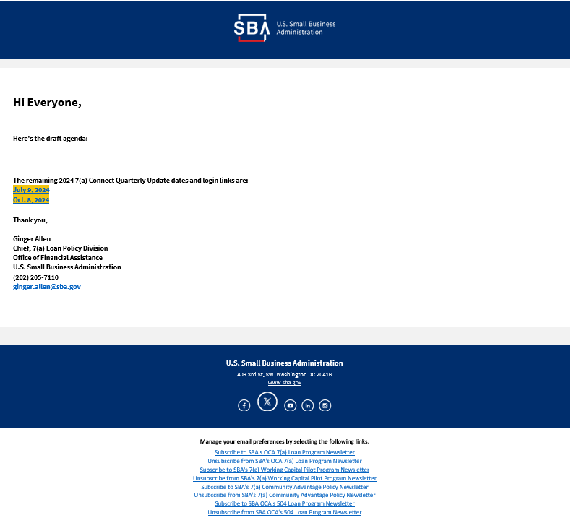
Subscribe/Unsubscribe to SBA OCA 7(a) Loan Program News
Emails will come from SBAOCANotifications@sba.gov. Please whitelist this email address
Subscribe to SBA's OCA 7(a) Loan Program Newsletter
Subscribe to SBA's 7(a) WCP Newsletter
Subscribe to SBA's 7(a) Community Advantage Newsletter
Subscribe to SBA's OCA 504 Loan Program Newsletter
Unsubscribe from SBA's OCA 7(a) Loan Program Newsletter
Unsubscribe from SBA's 7(a) WCP Newsletter
Unsubscribe from SBA's 7(a) Community Advantage Newsletter
Unsubscribe from SBA's OCA 504 Loan Program Newsletter
The subscribe/unsubscribe links at the bottom of OFA’s emails will work for anyone and can be forwarded multiple times

Slide 118
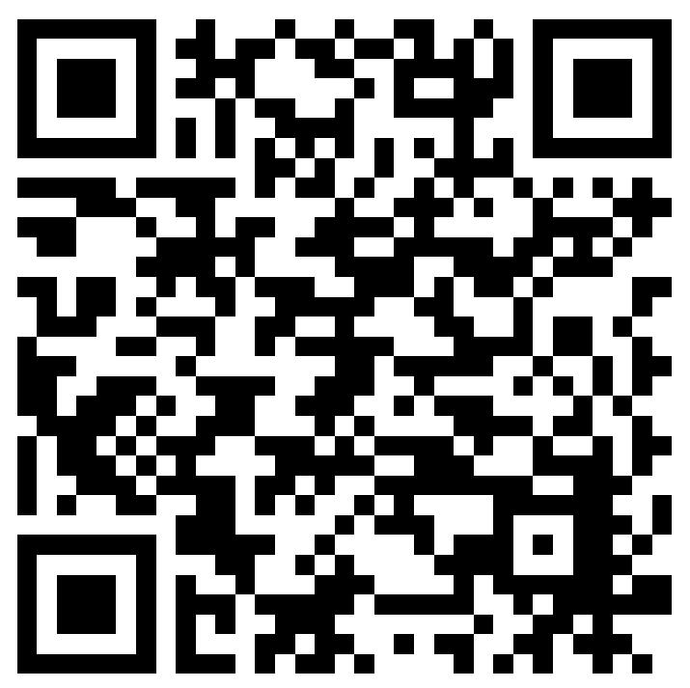
SBA Office of Capital Access LinkedIn

Slide 119
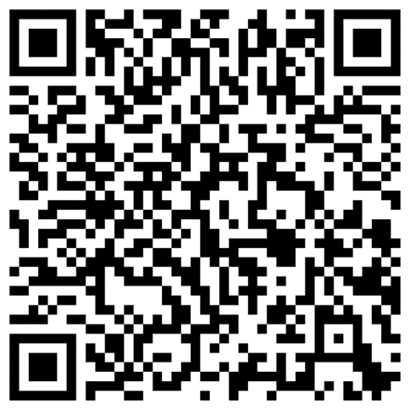
Subscribe to SBA’s OCA 7(a) Loan Program Newsletter

Slide 120
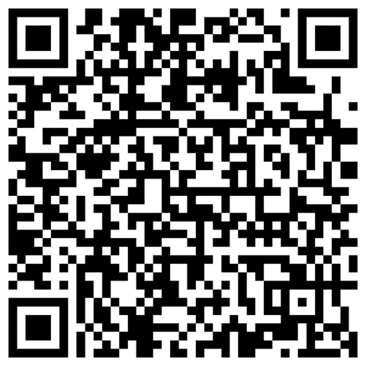
Subscribe to 7(a) Working Capital Pilot Newsletter

Slide 121
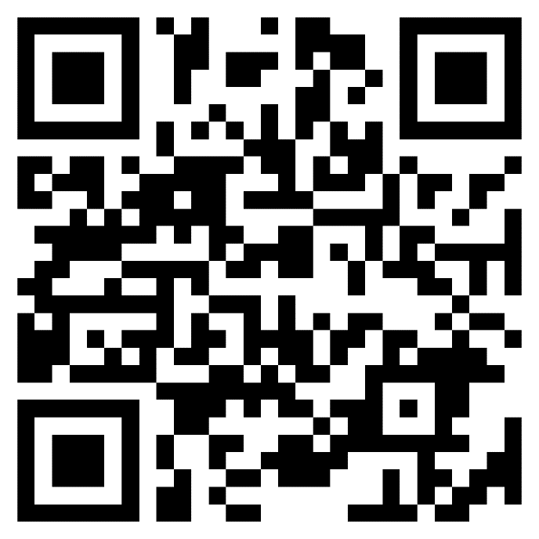
SBA’s Training On Demand Web Page
SBA’s Training On Demand webpage is now organized by topic for ease of use
Scan the code below to see the Training on Demand page

